Slide 1
https://www.geogebra.org/m/x3wvxh7n
Simple Affine Cipher
Adam Rowley and Natalia Wilson

Slide 2
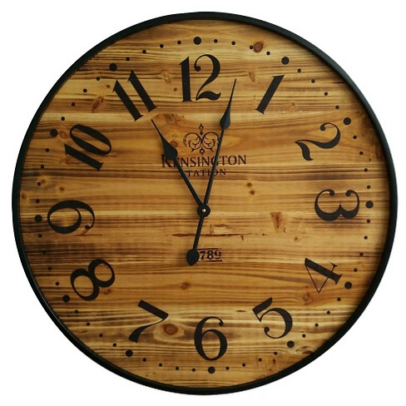
Letter Substitution

Slide 3
But wait!... One Rule
((x+A) B) Mod 26
There are constraints on the value of B!
B must be Coprime with 26 and less than 26.
Coprime- The greatest common divisor is 1.
Possible values of B: 1, 3, 5, …, 25.

Slide 4
Algorithms
Letter and word frequency.
The difference between numbers.

Slide 5
Encrypted: https://www.geogebra.org/m/x3wvxh7n
B ubotabl, ra b wrirbiuwbengzh dnognohn, zd b dnognohn gwbg hrogbzod nmnav inggna rq gwn biuwbeng bg inbdg rohn. Gwn lrdg qblrjd ubotabl zd gwn gwzagv-qzmn inggna irot dnognohn:
“Gwn xjzhf qrs cjlud rmna gwn ibyv earpo krt.”
Gwrjtw gwnan ban rgwna nsbluind db pnii!
“Gwn qzmn erszot pzybakd cjlu xjzhfiv.”
“Duwzos rq eibhf xjbagy, wnba lv mrp.”

Slide 6
Decrypted:
A pangram, or a holoalphabetic sentence, is a sentence that contains every letter of the alphabet at least once. The most famous pangram is the thirty-five letter long sentence:
“The quick fox jumps over the lazy brown dog.”
Though there are other examples as well!
“The five boxing wizards jump quickly.”
“Sphinx of black quartz, hear my vow.”

Slide 7
HELP!!
Junft leph-gqocv xisw kryd zamb.

Slide 8
Decoded Message and Meaning!
Junky qoph-flags vext crwd zimb.
An Abyssinian fly playing a Celtic violin was annoyed by trashy flags on which were the Hebrew letter qoph.

